Slide 1

Exploring Reinforcement Learning Solutions for EV-aware Optimal Power Flow Under Uncertainty Mid-term Presentation Master Thesis
Chia-Ling Yang
Technical University Munich (TUM)
Chair of Production and Supply Chain Management
Prof. Dr. Martin Grunow
Superviosr: Bahar Okumusoglu
Munich, 23rd of September 2024

Slide 2
Agenda
Background
Problem Formulation
RL Fundamentals
Literature Review
Methodology
Implementation – Preliminary Result
Outlook
Chia-Ling Yang | Exploring Reinforcement Learning Solutions for EV-aware Optimal Power Flow Under Uncertainty

Slide 3
Background

Slide 4

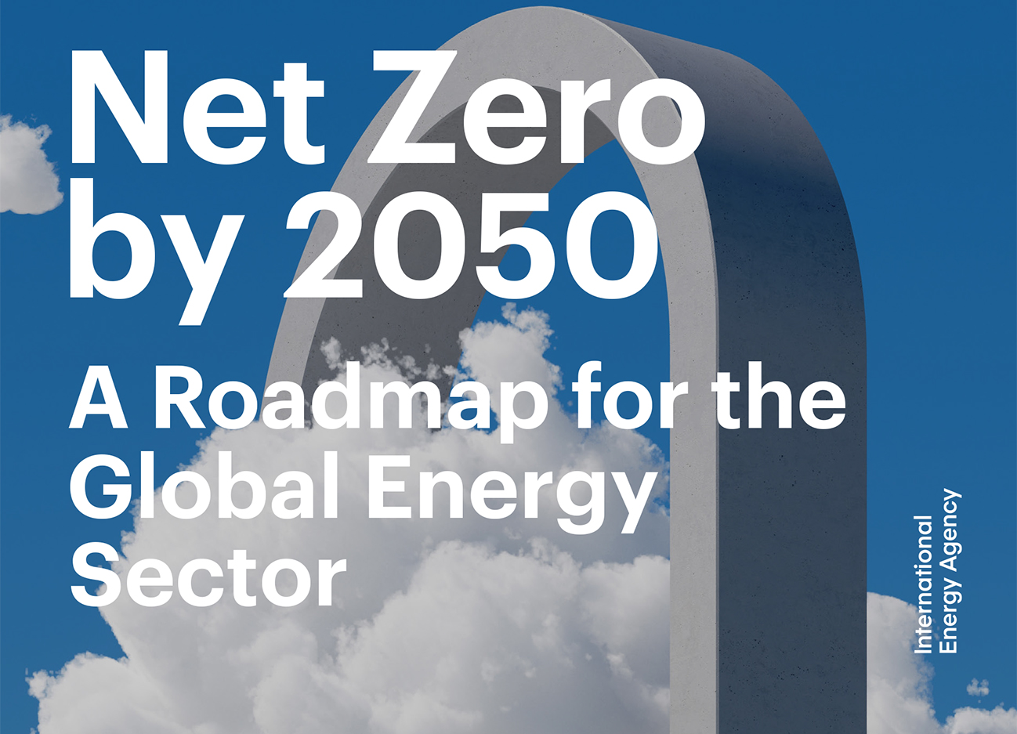



Background
Problem Formulation
RL Fundamental
Literature Review
…
Outlook
Renewable Energy Integration
Bouckaert et al. (2021) "Net zero by 2050: A roadmap for the global energy sector."
Low Carbon Emission Transportation
Chia-Ling Yang | Exploring Reinforcement Learning Solutions for EV-aware Optimal Power Flow Under Uncertainty
Notes:
A roadmap for global energy sector proposed by International Energy Agency

Slide 5

“Security- and Human-centered Energy Transition”
Background
Problem Formulation
RL Fundamental
Literature Review
…
Outlook
IEA (2023). “World Energy Outlook 2023” https://www.iea.org/reports/world-energy-outlook-2023
Rising Importance of Distribution System/Network Operator (DSO)
Decentralization
Renewable Energy Integration
High Uncertainty
Energy Demand
Instability of Distribution Network
Fast Charging
Extreme Weather
Low Carbon Emission Transportation
Chia-Ling Yang | Exploring Reinforcement Learning Solutions for EV-aware Optimal Power Flow Under Uncertainty
Notes:
Who cares about the problem? Why is the problem important for them?
Important for DSO
If not carefully taken care: cascading failure, prompt break down

Slide 6
Problem Formulation

Slide 7






Background
Problem Formulation
RL Fundamental
Literature Review
…
Outlook
Load
Optimal Power Flow
DSO
Generation
Battery
Chia-Ling Yang | Exploring Reinforcement Learning Solutions for EV-aware Optimal Power Flow Under Uncertainty
Notes:
To minimize the generation cost while maintaining energy balance in the grid and operational constraints

Slide 8
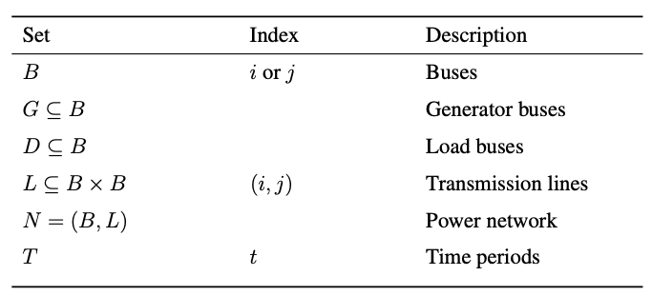
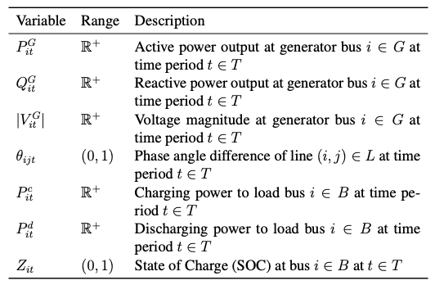
Optimal Power Flow
Background
Problem Formulation
Literature Review
Methodology
Outlook
Set and index
Decision variable
Chia-Ling Yang | Exploring Reinforcement Learning Solutions for EV-aware Optimal Power Flow Under Uncertainty

Slide 9
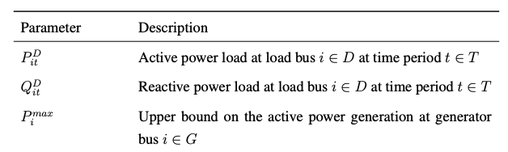
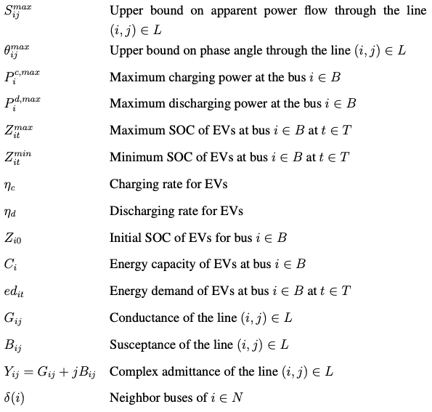
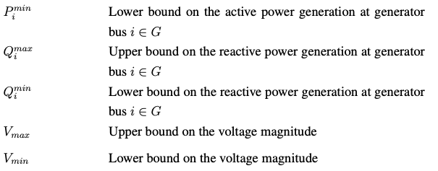
Optimal Power Flow
Background
Problem Formulation
RL Fundamental
Literature Review
…
Outlook
Parameters
Chia-Ling Yang | Exploring Reinforcement Learning Solutions for EV-aware Optimal Power Flow Under Uncertainty

Slide 10
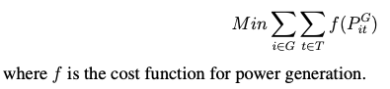
Optimal Power Flow
Background
Problem Formulation
RL Fundamental
Literature Review
…
Outlook
Objective Function – Generation cost minimization
Chia-Ling Yang | Exploring Reinforcement Learning Solutions for EV-aware Optimal Power Flow Under Uncertainty

Slide 11
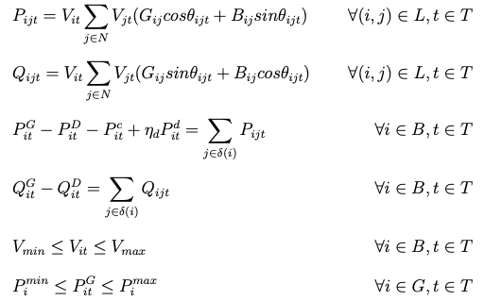
Optimal Power Flow
Background
Problem Formulation
RL Fundamental
Literature Review
…
Outlook
Constraints
(1) Active power calculation of lines
(2) Reactive power calculation of lines
(3) Active power balance at nodes
(4) Reactive power balance at nodes
(5) Voltage limitation at nodes
(6) Active power generation limitation
Chia-Ling Yang | Exploring Reinforcement Learning Solutions for EV-aware Optimal Power Flow Under Uncertainty

Slide 12
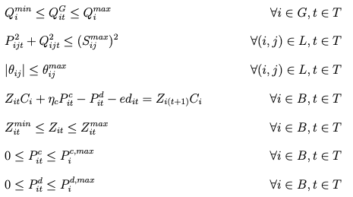
Optimal Power Flow
Background
Problem Formulation
RL Fundamental
Literature Review
…
Outlook
Constraints
(7) Reactive power generation limitation
(8) Apparent power (line load) limitation
(9) Phase angle limitation
(10) Energy balance of EV charging
(11) State of charge (SOC) limitation
(12) Charging limitation
(13) Discharging limitation
Chia-Ling Yang | Exploring Reinforcement Learning Solutions for EV-aware Optimal Power Flow Under Uncertainty

Slide 13
Reinforcement Learning (RL) provides potentials to tackle the non-convex, non-linear OPF problem with high uncertainty in the real world.
Background
Problem Formulation
RL Fundamental
Literature Review
…
Outlook
Solving OPF is challenging
RL is a promising
Non-convexity
Non-Linearity
Uncertainty
Robustness
Fast online implementation
Chia-Ling Yang | Exploring Reinforcement Learning Solutions for EV-aware Optimal Power Flow Under Uncertainty
Notes:
For fast online implementation: Current requirement: 15 min and in the future it might decrease due to the introduction of real time pricing.

Slide 14
Reinforcement Learning Fundamental

Slide 15
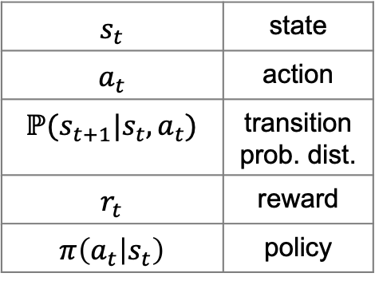






Markov Decision Process
Background
Problem Formulation
RL Fundamental
Literature Review
…
Outlook
$$s_{t}$$ | state
$$a_{t}$$ | action
$$ℙ(s_{t+1}|s_{t},a_{t})$$ | transition prob. dist.
$$r_{t}$$ | reward
$$π\left(a_{t} | s_{t}\right)$$ | policy
$$ℙ(s_{t+1}|s_{t},a_{t})$$
Environment
$$s_{t}$$
$$s_{t+1}$$
$$a_{t}$$
$$r_{t}$$
Agent
$$π(a_{t}|s_{t})$$
Chia-Ling Yang | Exploring Reinforcement Learning Solutions for EV-aware Optimal Power Flow Under Uncertainty

Slide 16

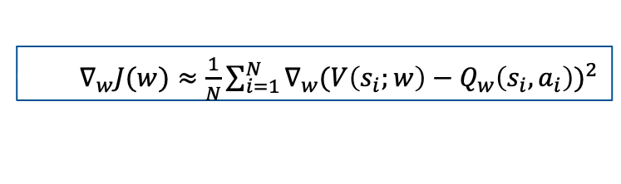


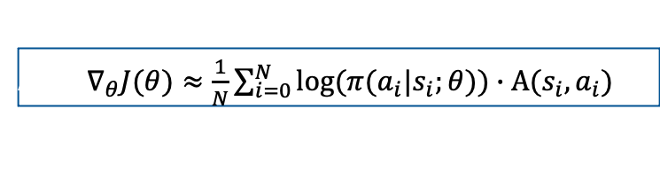

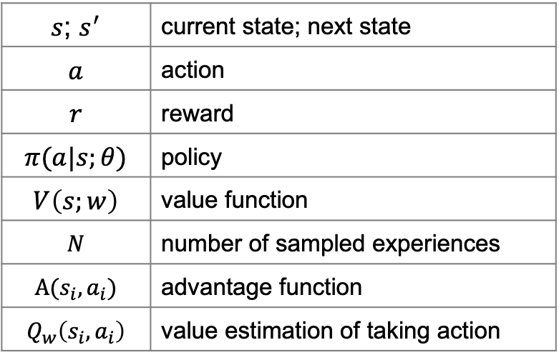




Actor-Critic Framework
Background
Problem Formulation
RL Fundamental
Literature Review
…
Outlook
$s$; $s^{′}$ | current state; next state
$$a$$ | action
$$r$$ | reward
$$π(a|s;θ)$$ | policy
$$V\left(s;w\right)$$ | value function
$$N$$ | number of sampled experiences
$$\text{A}\text{(}s_{i},a_{i})$$ | advantage function
$$Q_{w}\left(s_{i},a_{i}\right)$$ | value estimation of taking action
$$π(a|s;θ)$$
$$V\left(s;w\right)≅V(s)$$
$$V(s)$$
$$a$$
Actor
Critic
$$a$$
$$r$$
$$s$$
$$s^{′}$$
Actor
Actor$∇_{θ}J(θ)≈\frac{1}{N}\sum_{i=0}^{N}{log⁡(π(a_{i}|s_{i};θ)\text{)}∙\text{A}\text{(}s_{i},a_{i}) }$
Environment
Critic$∇_{w}J(w)≈\frac{1}{N}\sum_{i=1}^{N}{∇_{w}{(V\left(s_{i};w\right)−Q_{w}\left(s_{i},a_{i}\right))}^{2} }$
Critic
Chia-Ling Yang | Exploring Reinforcement Learning Solutions for EV-aware Optimal Power Flow Under Uncertainty
Notes:
Categories: value-based (Q-learning), policy-based(Reinforce) and hybrid(A-C)
A-C is preferred in our use case since it handles continuous action space better and at the same time it is more stable.

Slide 17
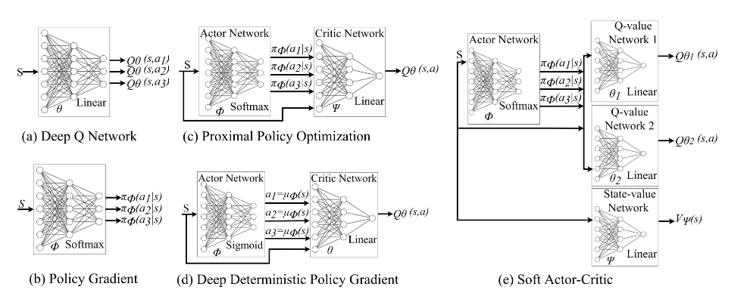
Common RL Algorithms
Background
Problem Formulation
RL Fundamental
Literature Review
…
Outlook
Massaoudi, M. S., Abu-Rub, H., & Ghrayeb, A. (2023). Navigating the landscape of deep reinforcement learning for power system stability control: A review. IEEE Access, 11, 134298-134317.
Chia-Ling Yang | Exploring Reinforcement Learning Solutions for EV-aware Optimal Power Flow Under Uncertainty

Slide 18
Literature Review

Slide 19
Background
Problem Formulation
RL Fundamental
Literature Review
…
Outlook
Title | Author | Journal | Year | Methodology | EV | RL | Without DC Approximation
The Promise of EV-Aware Multi-Period OPF Problem: Cost and Emission Benefits | Kayacık et al. | Sustainable Energy, Grids and Networks | 2023 | Second-Order Cone Programming (SOCP) | X
Symbiotic organisms search algorithm-based security-constrained AC–DC OPF regarding uncertainty of wind, PV and PEV systems | Duman et al. | Soft Computing | 2021 | Heuristic: Symbiotic Organisms Search | X
Optimal charging of electric vehicles in smart grid: Characterization and valley-filling algorithms | Chen et al. | 2012 IEEE SmartGridComm | 2012 | Heuristic: Valley-Filling Algorithm | X
Real-Time Optimal Power Flow: A "Lagrangian" Based Deep Reinforcement Learning Approach | Yan and Xu | IEEE Transactions on Power Systems | 2020 | Deep Deterministic Policy Gradient |  | X
A Data-driven Method for Fast AC Optimal Power Flow Solutions via Deep Reinforcement Learning | Zhou et al. | Journal of Modern Power Systems and Clean Energy | 2020 | Proximal Policy Optimization (PPO) |  | X
Feasibility Constrained Online Calculation for Real-Time Optimal Power Flow: A Convex Constrained Deep Reinforcement Learning Approach | Sayed et al. | IEEE Transactions on Power Systems | 2023 | Soft Actor-Critic |  | X
Network-Constrained Reinforcement Learning for Optimal EV Charging Control | Wu et al. | 2023 IEEE SmartGridComm | 2023 | Twin Delayed Deep Deterministic Policy Gradient (TD3) | X | X
This work |  |  |  | PPO | X | X | X
Chia-Ling Yang | Exploring Reinforcement Learning Solutions for EV-aware Optimal Power Flow Under Uncertainty

Slide 20
Methodology

Slide 21
Critical Components in RL – States and Actions
Background
Problem Formulation
…
Methodology
Implementation
Outlook
Grid network settings
EV driving demands
Power generation capacity
Power consumption
EV state of charge
Power flow solver (Newton-Raphson)…
Environment
States
Active power generation output
Reactive power generation output
Charging/Discharging power for EV
Agent
Actions
Chia-Ling Yang | Exploring Reinforcement Learning Solutions for EV-aware Optimal Power Flow Under Uncertainty
Notes:
### \(P_g\) and \(V_g\) as Actions:
- **Traditional Approach:** Many OPF formulations use \(P_g\) and \(V_g\) (generator voltage magnitudes) as control variables.
- **Advantages:** Voltage control through \(V_g\) directly affects reactive power flows and voltage stability in the grid.
- **Challenges:** Requires the RL agent to learn how voltage adjustments impact power flows, which may increase complexity.
### \(P_g\) and \(Q_g\) as Actions:
- **Alternative Approach:** By setting both active power (\(P_g\)) and reactive power (\(Q_g\)) as actions, you give direct control over both.
- **Advantages:** This simplifies the RL agent's task of balancing power generation and reactive power, potentially making learning more intuitive since \(Q_g\) directly affects voltage levels.
- **Challenges:** The relationship between \(Q_g\) and voltage magnitudes is non-linear, so the RL agent needs to indirectly control voltage through \(Q_g\).
In short, using \(P_g\) and \(Q_g\) as actions is a valid and potentially more intuitive approach, especially if the goal is to focus on directly controlling both active and reactive power flows in the grid. However, it may lead to different challenges in terms of the RL agent's learning process and the dynamics of how voltage is controlled.

Slide 22
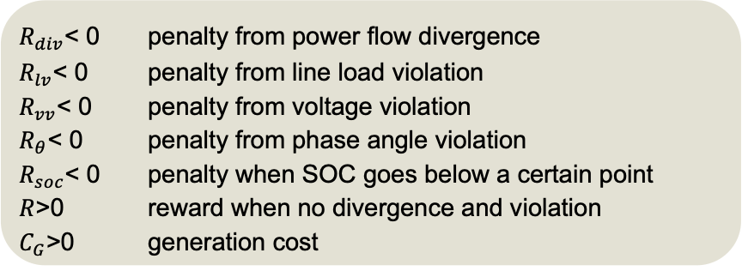
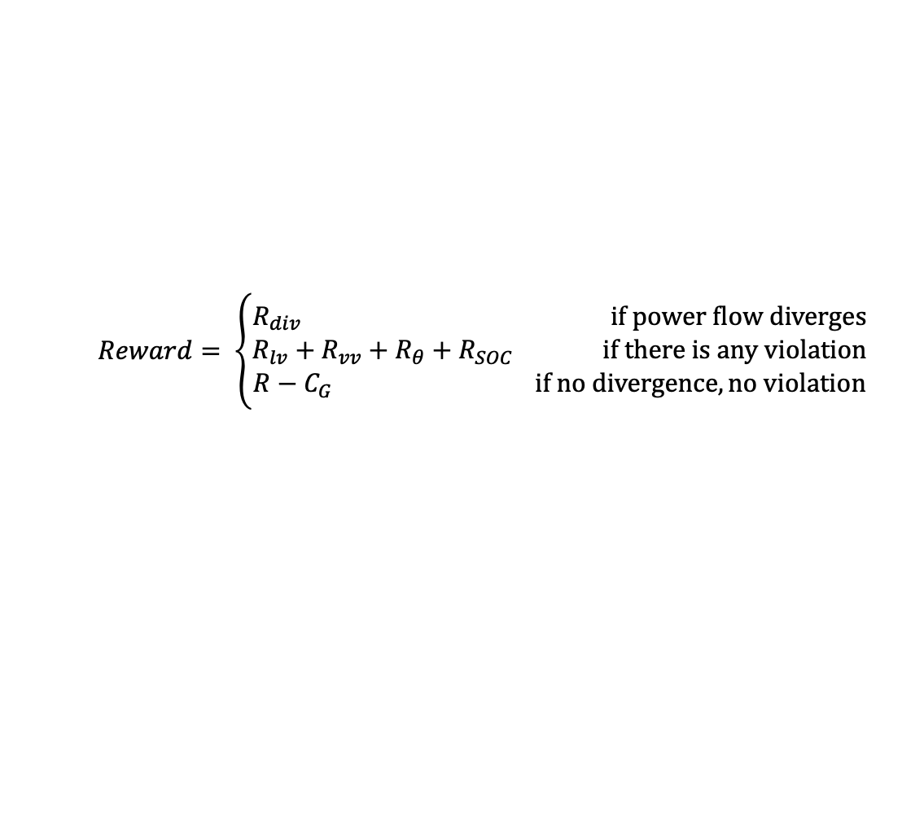
Critical Components in RL – Reward Function
Background
Problem Formulation
…
Methodology
Implementation
Outlook
$$Reward= \left\{\begin{aligned}R_{div} if power flow diverges \\ R_{lv}+R_{vv}+R_{θ}+R_{SOC} if there is any violation \\ R−C_{G} if no divergence, no violation\end{aligned}\right.$$
$R_{div}$< 0 penalty from power flow divergence
$R_{lv}$< 0 penalty from line load violation
$R_{vv}$< 0 penalty from voltage violation
$R_{θ}$< 0 penalty from phase angle violation
$R_{soc}$< 0 penalty when SOC goes below a certain point
$R$>0 reward when no divergence and violation
$C_{G}$>0 generation cost
Chia-Ling Yang | Exploring Reinforcement Learning Solutions for EV-aware Optimal Power Flow Under Uncertainty

Slide 23


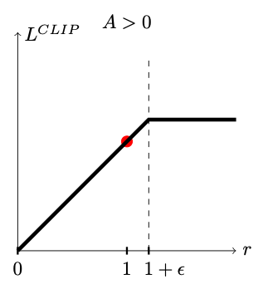
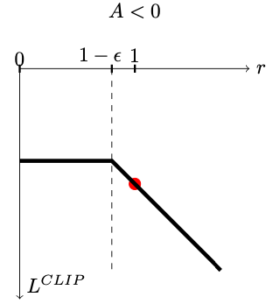


Proximal Policy Optimization
Background
Problem Formulation
…
Methodology
Implementation
Outlook
where
${\hat{A}}_{t}$: estimated advantage function
$ε$: small hyperparameter
Conservative updating!
Schulman, J., Wolski, F., Dhariwal, P., Radford, A., & Klimov, O. (2017). Proximal policy optimization algorithms. arXiv preprint arXiv:1707.06347.
Chia-Ling Yang | Exploring Reinforcement Learning Solutions for EV-aware Optimal Power Flow Under Uncertainty
Notes:
PPO was developed by John Schulman in 2017,^{[1]} and had become the default reinforcement learning algorithm at OpenAI. Many experts called PPO the state of the art because it seems to strike a balance between performance and comprehension. Compared with other algorithms, the three main advantages of PPO are simplicity, stability, and sample efficiency. → suits my situation perfectly since I do not own a data center.

Slide 24
Implementation - Training

Slide 25
Assumptions
Background
Problem Formulation
…
Methodology
Implementation
Outlook
The position of slack/reference bus does not change.
Neglecting transformers
There is an EV group at each load bus.
The number of EV in a group is the integer of the mean of active power at loads
The EVs at the same bus have the same battery capacity and the same driving demands.
Data Sample
Active power and reactive power of loads are randomly sampled with standard deviation =1.
Active power generation capacity is uniformly distributed between max. and min.
EV driving profile data comes from emobpy. [Gaete-Morales, C., Kramer, H., Schill, WP. et al. An open tool for creating battery-electric vehicle time series from empirical data, emobpy. Sci Data 8, 152 (2021). https://doi.org/10.1038/s41597-021-00932-9]
Chia-Ling Yang | Exploring Reinforcement Learning Solutions for EV-aware Optimal Power Flow Under Uncertainty

Slide 26
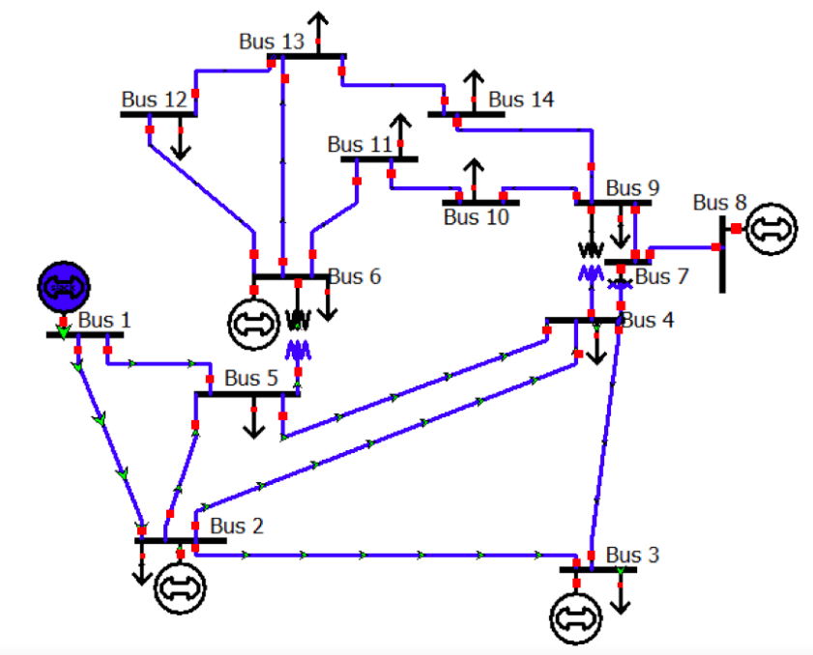
Test Case – IEEE 14 Bus System
Background
Problem Formulation
…
Methodology
Implementation
Outlook
Slack/Reference
Generator
Load

Slide 27
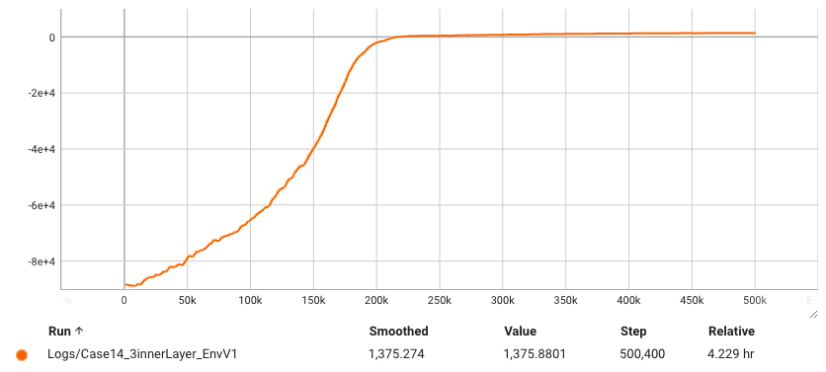
Training Performance
Background
Problem Formulation
…
Methodology
Implementation
Outlook
Expected reward per episode
Chia-Ling Yang | Exploring Reinforcement Learning Solutions for EV-aware Optimal Power Flow Under Uncertainty

Slide 28
Outlook

Slide 29
Evaluation of the RL model
Background
Problem Formulation
…
Methodology
Implementation
Outlook
Selecting a mathematical optimization method as benchmark
Second-order conic programming
More different test cases
IEEE Case 9
IEEE Case 30
and more…
Chia-Ling Yang | Exploring Reinforcement Learning Solutions for EV-aware Optimal Power Flow Under Uncertainty

Slide 30
Q&A

Slide 31
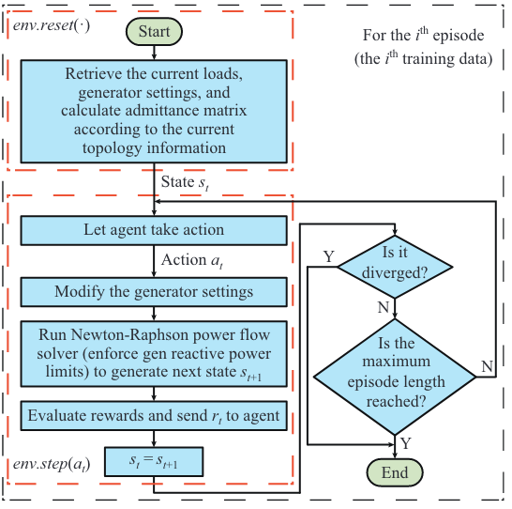
Appendix
Zhou, Y., Lee, W. J., Diao, R., & Shi, D. (2021). Deep reinforcement learning based real-time AC optimal power flow considering uncertainties. Journal of Modern Power Systems and Clean Energy, 10(5), 1098-1109.
Chia-Ling Yang | Exploring Reinforcement Learning Solutions for EV-aware Optimal Power Flow Under Uncertainty

Slide 32
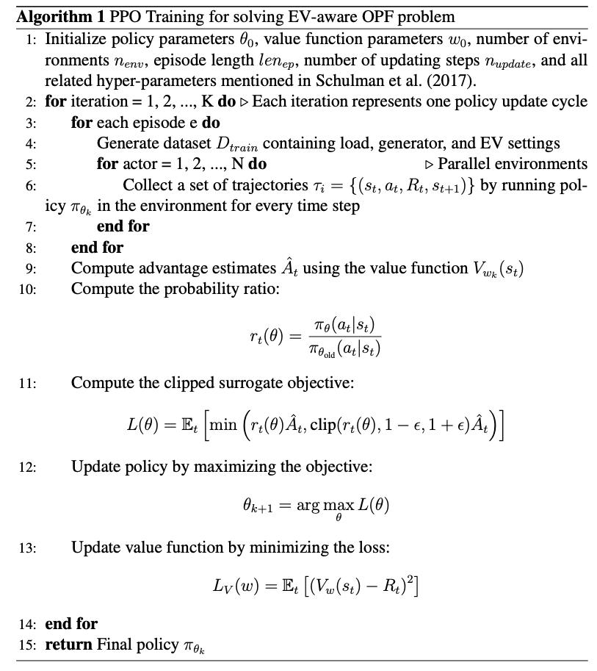
Appendix – Pseudo Code
Chia-Ling Yang | Exploring Reinforcement Learning Solutions for EV-aware Optimal Power Flow Under Uncertainty

